Slide 1
Data Structures
CSE-207
Data Structure
Md. Manowarul Islam
Associate Professor
Dept. of CSE, Jagannath University

Slide 2
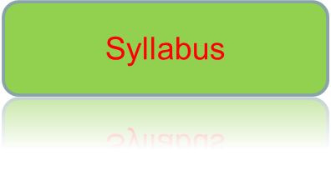

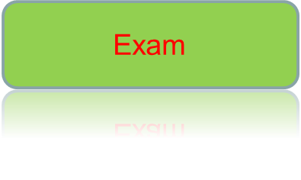

Today’s topics
Data Structure

Slide 3
About Course
Course Code: CSE-207
Course Title: Data Structures
Course Teacher: Md. Manowarul Islam
Credit: 4

Slide 4
Overview
Data Structure
These may vary !!!!!
Number of Class: 24
Number of Mid-Term : 2
Number of Quiz : 3
Final Exam: 1

Slide 5
Overview
Data Structure
Number of Class: 24
Number of Mid-Term : 1 30*1=30
Number of Quiz : CT 10=10
Final Exam: 1 30*1=30
Lab : =15
Project =10
Attendance =5

Slide 6
Syllabus
Data Structure
Introduction
Elementary data organization
Data structures
Data structure operations
Algorithmic notation
String processing

Slide 7
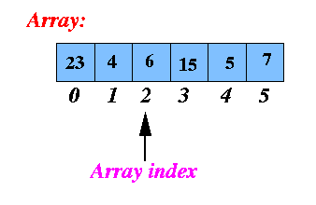
Syllabus
Data Structure
Arrays
Linear arrays
Representation of array
Traversing linear arrays
Inserting and deleting in arrays
Bubble sort
Linear search
Binary search
Multidimensional arrays

Slide 8
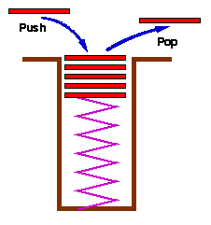
Syllabus
Data Structure
Stack
Stack
Array representation of stack
Linked representation of stack
Polish notation

Slide 9
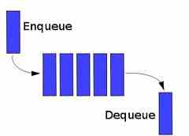
Syllabus
Data Structure
Queues
Queues
Array representation of queue
Deques
Priority queue

Slide 10
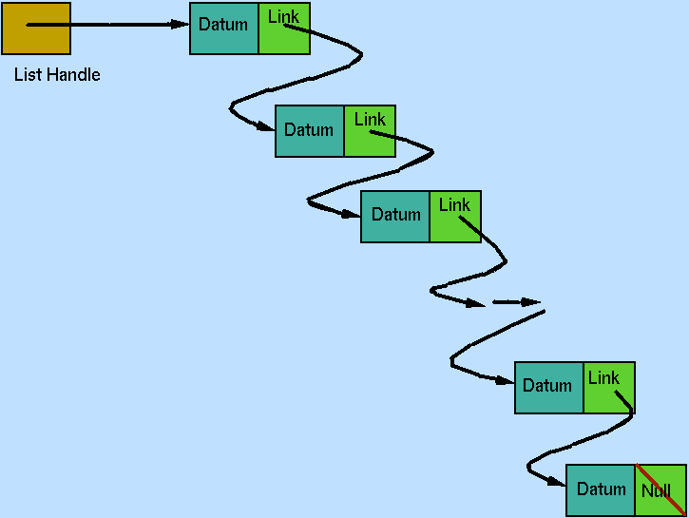
Syllabus
Data Structure
Linked Lists
Linked lists
Representation of linked lists
in memory
Traversing a linked list
Searching a linked list
Insertion into a linked list
Deletion from a linked list
Header linked list
Two way lists

Slide 11
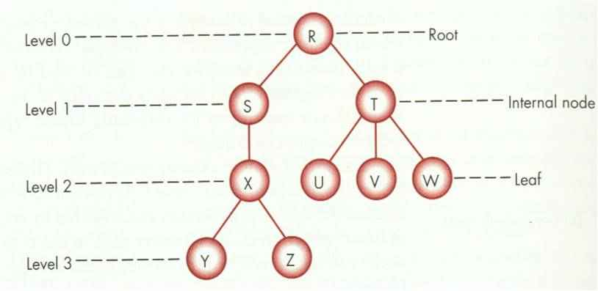
Syllabus
Data Structure
Trees
Binary trees
Representing binary trees
Traversing binary trees
Binary search trees
Searching and inserting in BST
Deleting in BST
Heap
Heap sort
Huffman’s algorithm

Slide 12
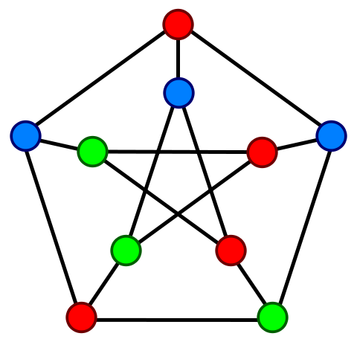
Syllabus
Data Structure
Graphs
Graph
Adjacency matrix
Path matrix
Warshall’s algorithm
Linked representation of graph
BFS
DFS

Slide 13
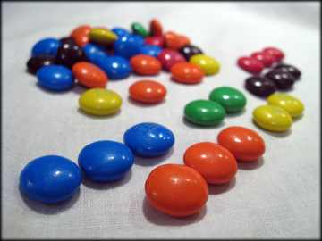
Syllabus
Data Structure
Sorting
Insertion sort
Selection sort
Merge Sort
Bubble sort

Slide 14


Syllabus
Data Structure
Searching
Searching technique
Linear search
Binary search

Slide 15

Exam
Data Structure

Slide 16
Book
Data Structure
Data Structures
Seymour Lipschutz
Introduction to Algorithm
      T H. Cormen
      C. E. Leiserson
      R. L Rivest
      C. Stein

Slide 17
Data Structure
Any Question???

